Slide 1
Revitalizing Health: A Natural Solution to Hormone Balance
Geoff Melcher B.S. M.S.

Slide 2
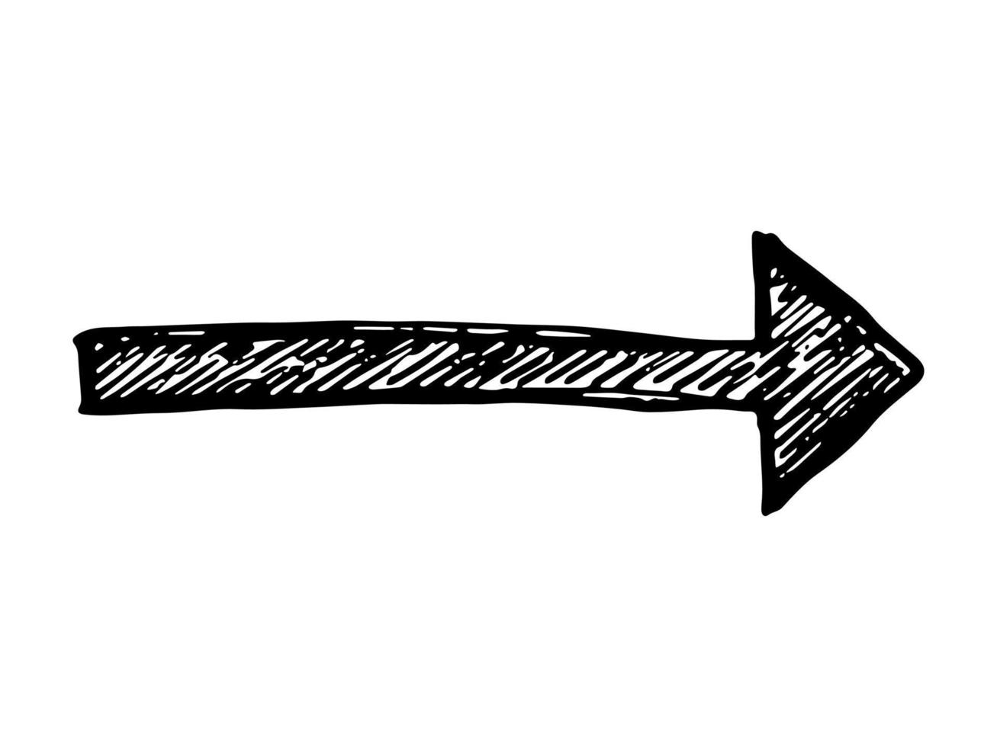
Download slides and watch presentation!

Slide 3
Introduction
Why are you so important?
Why do people try something?

Slide 4
You are so important because we are looking for people around us to have all the answers.
When you share information on something you are now giving a review.
You are now … THE EXPERT
You are now … THE PYSICIAN
You are now … THE SPECIALIST
You are now … THE HEALER
You are now … THE MD
You are now … THE GENERAL PRATITIONER

Slide 5
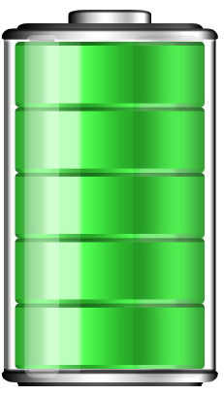
Information = Power
That is why are started my career in science and research.
East Park Naturals is a company centered around research and information.
Hormones are produced by our endocrine glands, thyroid, pancreas and ovaries or testes. Hormones perform essential functions, relay important warnings and communicate messages throughout the body.

Slide 6
Hormones are the most potent chemical messengers in our bodies.
Notes:
Hormones are an on off switch. When you were younger you did not think about your hormones working because they just worked. You only notice when there are symptoms that are less than desirable. Lets be sure your hormones are turned on.

Slide 7
Hormones are the most potent chemical messengers in our bodies.
Notes:
You are either connected or your not. Your hormones are either connected and interacting or they are not. Hormones are just like being connected to Wifi.

Slide 8
7 Signs There is a Hormone Problem
1) Fatigue
Everyone is tired sometimes. But you should recover with adequate rest, hydration and a healthy diet. If you feel you are taking care of yourself but are still exhausted or just can’t seem to get back to your best, take a look at your hormone levels.
Notes:
Fatigue: Everyone is tired sometimes. But you should recover with adequate rest, hydration and a healthy diet. If you feel you are taking care of yourself but are still exhausted or just can’t seem to get back to your best, take a look at your hormone levels. Adrenal fatigue and hypothyroidism are more prevalent in our high-paced society than you may think.

Slide 9
7 Signs There is a Hormone Problem
It’s not “all in your head”
2) Anxiety
Neuroendocrinology is the study of the intimate relationship of the neurotransmitters, or chemical messengers of the brain, and hormones. Excess adrenal stimulation due to the outrageous stress that we subject ourselves to has become a silent epidemic. We know eating the right foods and techniques such as meditation, and deep breathing engages the relaxation side of your nervous system rather than the “fight-or-flight” impulses.
Notes:
Anxiety: It’s not “all in your head”. Neuroendocrinology is the study of the intimate relationship of the neurotransmitters, or chemical messengers of the brain, and hormones. Excess adrenal stimulation due to the outrageous stress that we subject ourselves to has become a silent epidemic. We know eating the right foods and techniques such as meditation, and deep breathing engages the relaxation side of your nervous system rather than the “fight-or-flight” impulses.

Slide 10
7 Signs There is a Hormone Problem
3) Weight Gain
Why is it that so many people struggle with weight fluctuations? It’s because we are starving ourselves and working so hard. The body experiences these challenges as stress. And when the body is stressed, it produces more Cortisol. Cortisol tells your body to hang on to that fat because it’s a great storage form of energy.
Notes:
Weight Gain: Why is it that so many people struggle with weight fluctuations? It’s because we are starving ourselves and working so hard. The body experiences these challenges as stress. And when the body is stressed, it produces more Cortisol. Cortisol tells your body to hang on to that fat because it’s a great storage form of energy.

Slide 11
7 Signs There is a Hormone Problem
There are many reasons why someone may be having difficulty sleeping. If it’s persistent, it’s likely related a hormonal imbalance. Melatonin, is a hormone released by the pineal gland in the brain. It is intimately related and affected by the other hormones. Hormones are complicated game of chess. If you move one, it affects all the others. If you are not sleeping well, it would be wise to have a professional assist you.
4) Insomnia
Notes:
Insomnia: There are many reasons why someone may be having difficulty sleeping. But if it’s persistent, it’s likely related a hormonal imbalance. Melatonin, the well-known sleep chemical, is a hormone released by the pineal gland in the brain. As a hormone, it is intimately related and affected by the other hormones. You can think of the different hormones as pieces in a complicated game of chess. If you move one, it affects all the others and they have to move accordingly. With certain moves, things can get dangerous. If you are not sleeping well, it would be wise to have a professional assist you.

Slide 12
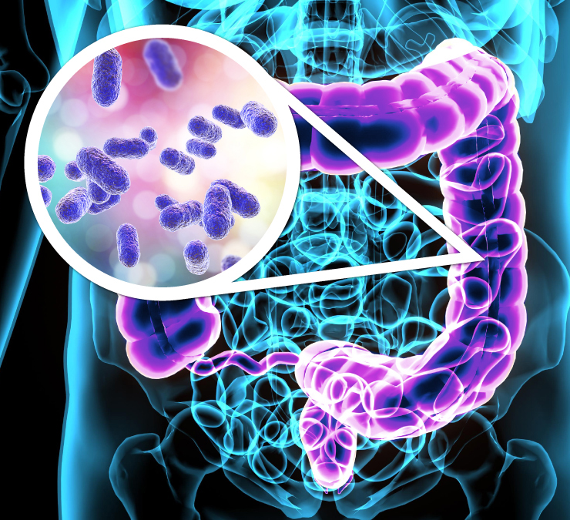
7 Signs There is a Hormone Problem
5) Irritable Bowl Syndrome
There are more neurotransmitters in the gut than there are in the brain. So it should be no surprise that IBS is related to conditions such as anxiety and depression. Hormones influence gut function in other ways as well such as affecting the microbiome of the gut, the bacterial system in our intestines. Hormone imbalances can lead to imbalances in our bacterial colonies influencing their numbers and function.
Notes:
IBS: There are more neurotransmitters in the gut than there are in the brain. So it should be no surprise that IBS is related to conditions such as anxiety and depression. Hormones influence gut function in other ways as well such as affecting the microbiome of the gut, the bacterial system in our intestines. Hormone imbalances can lead to imbalances in our bacterial colonies influencing their numbers and function.

Slide 13
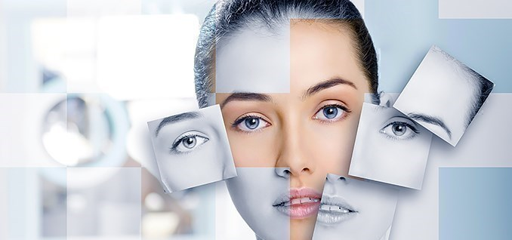
7 Signs There is a Hormone Problem
6) Skin & Hair Changes
The quality and vitality of your skin and hair is directly related to your hormone. Thyroid abnormalities, for example, may cause dry hair or skin, thinning hair, hair loss or brittle nails.
7 Signs There is a Hormone Problem
6) Skin and
Hair Changes
Notes:
Skin and Hair Changes: The quality and vitality of your skin and hair is directly related to your hormones. Thyroid abnormalities, for example, may cause dry hair or skin, thinning hair, hair loss or brittle nails.

Slide 14
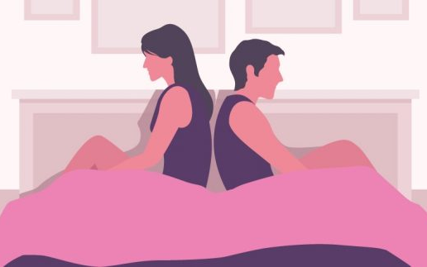
7 Signs There is a Hormone Problem
7) Low Sex Drive
Both men and women are subject to irregularities related to their sex hormones. And both men and women have relatively appropriate levels of estrogen, progesterone, DHEA and testosterone. Although women have a more obvious gauge of hormone balance via menstruation, both sexes can experience sexual dysfunction or issues with libido due to the complex intricacies and interactions of these powerful substances.
Notes:
PMS and Low Sex Drive: Both men and women are subject to irregularities related to their sex hormones. And both men and women have relatively appropriate levels of estrogen, progesterone, DHEA and testosterone. Although women have a more obvious gauge of hormone balance via menstration, both sexes can experience sexual dysfunction or issues with libido due to the complex intricacies and interactions of these powerful substances.

Slide 15
Living Better Through Nature
7 Signs There is a Hormone Problem
Fatigue
Anxiety
Weight Gain
Insomnia
IBS
Skin and Hair Changes
Low Sex Drive

Slide 16
Living Better Through Nature
How do “YOU” spell Hormone Relief?
Mechanical Relief
Hormone Replacement Therapy
Bio-Identical Hormones
Phytoestrogen & androgen
Essential Trace Elements
Notes:
Everything is not all doom and gloom. Here are some options that you have available.

Slide 17
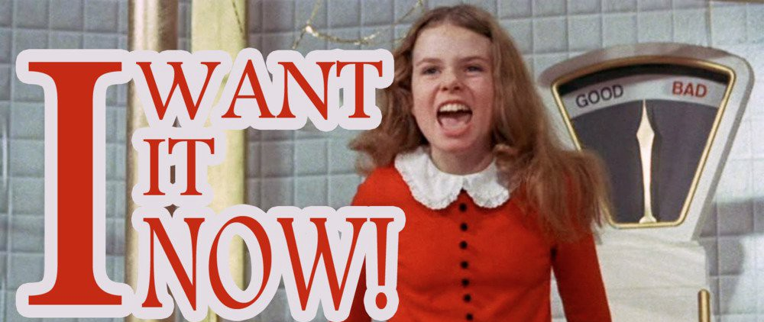
Mechanical Relief
Fans
Little Blue Pill
Treadmill
Gym Membership
My Pillow
AC
Cosmetic products
Probiotics
Coffee
Notes:
Mechanical Relief are all of the quick answer items such as:

Slide 18
Hormone Replacement Therapy (HRT)
HRT for the correct reasons demonstrates amazing results but does requires some work.
Regular Checkups with GP
Regular Blood Tests
Be sure you are on the lowest does possible, and, only as long as necessary.
One must be aware of the following:
You become a number on a chart
Deal with the numerous side effects
Heart disease Heart attacks, blood clots and/or strokes.
Notes:
You are theoretically directly replacing your declining levels of hormone.
Been around since 1940. 1966 some concerning data came out.
Grandfather story with side effects. No idea what I was thinking
Example of testosterone study.
Use it or loose it. This is important because of quality of life.

Slide 19
Hormone Replacement Therapy (HRT)
HRT for the correct reasons demonstrates AMAZING results but does requires some work.
Regular Checkups with GP
Regular Blood Tests
Be sure you are on the lowest does possible, and, only as long as necessary.
One must be aware of the following:
You become a number on a chart
Deal with the numerous side effects
Heart disease Heart attacks, blood clots and/or strokes.
Notes:
You are theoretically directly replacing your declining levels of hormone.
Been around since 1940. 1966 some concerning data came out.
Grandfather story with side effects. No idea what I was thinking
Example of testosterone study.
Use it or loose it. This is important because of quality of life.

Slide 20
Bio-Identical Hormones “Natural” Hormones
Bio-identical hormones are hormone preparations which are identical molecules to those produced by the body.
Just like HRT: Hormones are produced by pharmaceutical companies and properly licensed for use, and there is absolutely no evidence that the bio-identical hormones are any safer than those used in traditional HRT.
“Bio-Identical” hormones will carry the same benefits and risks as HRT.
Skin Patch Gels
Mouth Patch Injections
Implants
Notes:
Bio-Identical hormones or natural hormones are hormones that are prepared to be identical to those produced by the body. However, the hormones are still made by compounding chemists which are claimed to be safer than “traditional” hormones used in Hormone Replacement Therapy (HRT).
There is zero clinical data that they are safer. They do come from a different source. IE plants instead of horse urine. There is that.
Please note! Bio-Identiacl hormones will carry the same benefits and risks as HRT.

Slide 21
Living Better Through Nature
How do “YOU” spell Hormone Relief?
Mechanical Relief
Hormone Replacement Therapy
Bio-Identical Hormones
Phytoestrogen & androgen
Essential Trace Elements
Notes:
Lets see what happens when we take a look at living better through nature

Slide 22
“Phyto” means plants
Phyto-estrogen: are estrogen like chemicals found in some plants
Phyto-androgen: are substances produced in plants which have effects similar to testosterone.
However, this form is much weaker than your natural hormones produced.
Phytoestrogen & Phytoandrogen
Notes:
Vegetables, fruit, some grains, legumes
Meat, fruit, vegi
Phyto” means plants
Phyto-estrogen: are estrogen like chemicals found in some plants and
Phyto-androgen: are plants that have effects similar to testosterone.
However, this form is much weaker than your natural hormones produced.
What doe all these have in common?
Mechanical Relief, Hormone Replacement Therapy, Bio-Identical Hormones, along with food are all outside sources for hormone relief.

Slide 23
Essential Trace Elements
Essential trace elements (ETE) are naturally occurring trace minerals that are required by humans in very tiny amounts.
Range from 18 milligrams to 50 micrograms.
How many grams, milligrams or micrograms is equal to $0.01?
Notes:
Essential trace elements (ETE) are naturally occurring
trace minerals that are required by humans in very tiny amounts.
Range from 18 milligrams to 50 micrograms.
How many grams, milligrams or micrograms is equal to $0.01?
120

Slide 24
Science continues to work on which ones and how much are critical for healthy living and how they work with our bodies.
We depend on at least 9 trace elements: iron, zinc, copper, manganese, iodine, chromium, selenium, molybdenum and cobalt.
These are for optimum metabolic function.
What do these Essential Trace Elements do?
1. Trigger chemical reactions to produce essential compounds.
2. Key structures of vital body parts (iron for blood).
3. Protection from abnormalities (dementia).
4. Interacting with macromolecules such as enzymes, biological membranes and HORMONES.
Essential Trace Elements
Notes:
Science continues to work on which ones and how much are critical for healthy living and how they work with our bodies.
We depend on at least 9 trace elements: iron, zinc, copper, manganese, iodine, chromium, selenium, molybdenum and cobalt.
These are for optimum metabolic function.
What do these ETE do?
1. Trigger chemical reactions to produce essential compounds.
2. Key structures of vital body parts (iron for blood).
3. Protection from abnormalities (dementia).
Interacting with macromolecules such as enzymes,
biological membranes and HORMONES.

Slide 25
Essential Trace Elements
7 Signs There is a Hormone Problem
Did you know that vitamins could not exist without trace minerals!
If we do not absorb the minerals we ingest, then they do not access most of our cells.
Malabsorption of trace minerals results in disease and a body that functions at a reduced capacity.
It is important to opt for trace minerals in an absorbable form that offer a good availability such as plant-based trace minerals so that the body can benefit.
Indium is the 49th element on the periodic table. How does this play a role in our bodies?
Notes:
Did you know that vitamins could not exist without trace minerals!
If we do not absorb the minerals we ingest, then they do not access most of our cells.
Malabsorption of trace minerals results in disease and a body that functions at a reduced capacity.
It is important to opt for trace minerals in an absorbable form that offer a good availability such as plant-based trace minerals so that the body can benefit.
Indium is the 49th element on the periodic table. How does this play a role in our bodies?
ABSORPTION. But how do I know this. Let me tell you a little bit about EPR and who we are.

Slide 26
Our History
Started to Save One Life
25 Years of Experience
Family Owned & Operated
Notes:
Necessity is the mother of all inventions. Well, before our family experienced the tragic loss of a loved one shortly after he contracted HIV, there was no rock that we'd leave unturned in our effort to find a cure to save him. Although, he lost his battle to this aggressive disease, our family discovered something in our searching. We “discovered” something that researchers in fact had been testing for years; The olive leaf.
Eventually we contracted our own team of researchers to investigate this seemingly miraculous leaf to see if it really had the immunity powers many had claimed. To make a long story of research trials and lab tests short, it did! It proved it's immune boosting strength so much so that we were convinced we had to get it out there and that it needed to be on shelves everywhere! But, like many great things, we found it already was.
And after investigating the olive leaf products that were already out there, we found out why. The answer was in THE WAY other company's were getting that "magical" (no, not like unicorns) chemical, oleurpein, out of the leaves. When they extracted this chemical from the leaves they were destroying all the properties that made it so great, so powerful and so truly life-saving. So we went back to the lab and that's where d-Lenolate®, our signature olive leaf extract product, was born.
To cut another long story short, although there are other olive leaf extract products on the market today, none of them use our patented extraction process to obtain the “RIGHT” stereoisomer, d-Lenolate, that is the bio-available form of oleuropein.
As for those other questions about the media and the hype, all we can say is that we are an old family company founded in 1995. Think of us as your neighborhood mom and pop shop that just happened to grow a ton of olive trees in the back. To this day, we are still 100% family owned and operated, supported by a great team of researchers, colleagues and medical professionals that have all become like, well, family.
Our goal has never been to run off with money bags and exploit people's suffering (we're looking at you pharmecutical companies). Our mission as a company, and a family, is to do our best to share this incredible gift from nature with everyone and carry on the legacy of a young man whose life was tragically cut short.
We like to think of East Park Research as being born from our family's will to survive and our passion for helping enable others to live long and healthy lives, without the fear & pain of "limbo".

Slide 27
Why Now?
Previously customers found us when they were 50+. On the current environment we have younger customers and customers of all ages being proactive to care for their health/immune system

Slide 28
Indium Research
Indium: Effects on Growth and Life Span
Journal of Nutrition
Medical Use of Indium Sulfate
Hungarian Scientific Academy
Dr. Schroeder in 1971 found that after maturity, females without indium added 20% of their weight on as fat, while those supplementing with indium added on no fat at all. In many cases, people have lost weight due to enhanced energy.
For Male, indium helps maintain the muscle mass normally lost due to age-related declines in growth hormone; increased libido and better moods.
Notes:
We now know that these results are seen in both sexes.
Why have you never heard of this. Simple: Indium is not found in our food source.
Indium dramatically increases essential trace mineral absorption
Indium has huge beneficial effects on the thyroid and pituitary glands.

Slide 29
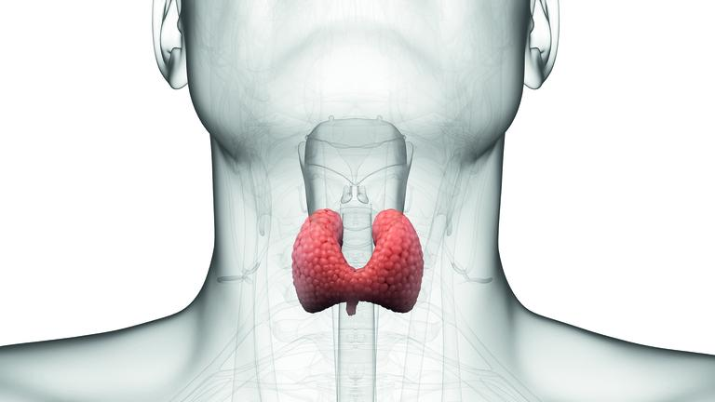
Indium = Absorption = Thyroid Function
By allowing you body to absorb and utilize essential trace minerals.
Your thyroid starts working like it once did.
Up to 60% of those with thyroid issues are unaware of their condition.
1 in 8 will develop a thyroid disorder.
The causes of thyroid problems are largely unknown.
The thyroid produces hormones that influence every cell, tissue and organ in the body.
Women are 5 to 8 times more likely than men to have thyroid problems.
Notes:
Hypo-Thyroid vs Hyper-Thyroid
Men vs Women
indium = absorption of ETE and ETE = thyroid function

Slide 30
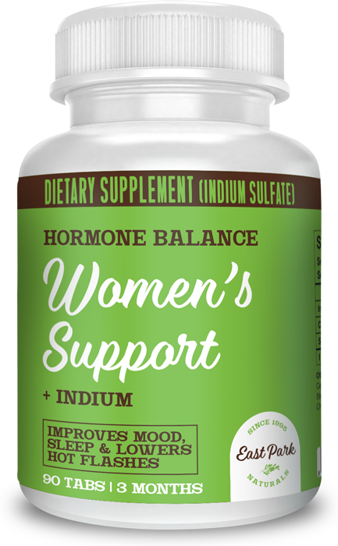
Women’s Support + Indium
Women’s Support + Indium helps your body regain its youthful level of natural hormones that are unique to you without using any synthetic hormones or plant-based mimics.
Indium is a rare trace mineral produced by our body until age 30. It is what our body needs to trigger its natural age-reversing, health-enhancing capabilities. Indium facilitates the absorption of essential minerals better than any other mineral.
All-natural
Hormone-free
Steroid-free
Gluten free
Indium/mineral-based
Clinically tested
Product Sizes
Quantity: 30 Tabs
Wholesale Price: $ 9.97
Retail Price: $ 19.95
SKU: 852295000247
Product Size: 1.5” x 2.6” x 1.5”
Quantity: 90 Tabs
Wholesale Price: $ 24.97
Retail Price: $ 49.95
SKU: 852295000230
Product Size: 1.5” x 2.6” x 1.5”

Slide 31
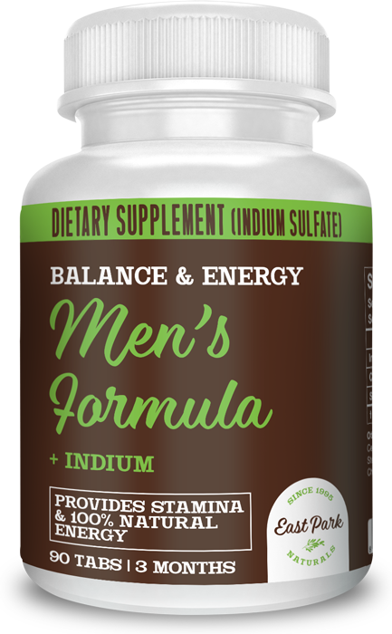
Men’s Formula + Indium
Men’s Formula + Indium helps you to achieve natural balance and energy. Increase your stamina, support a healthy weight and reach optimal hormone levels.
Indium is a rare trace mineral produced by our body until age 30. It is what our body needs to trigger its natural age-reversing, health-enhancing capabilities. Indium facilitates the absorption of essential minerals better than any other mineral.
All-natural
Hormone-free
Steroid-free
Gluten free
Indium/mineral-based
Clinically tested
Product Sizes
Quantity: 30 Tabs
Wholesale Price: $ 9.97
Retail Price: $ 19.95
SKU: 852295000339
Product Size: 1.5” x 2.6” x 1.5”
Quantity: 90 Tabs
Wholesale Price: $ 24.97
Retail Price: $ 49.95
SKU: 852295000322
Product Size: 1.5” x 2.6” x 1.5”

Slide 32
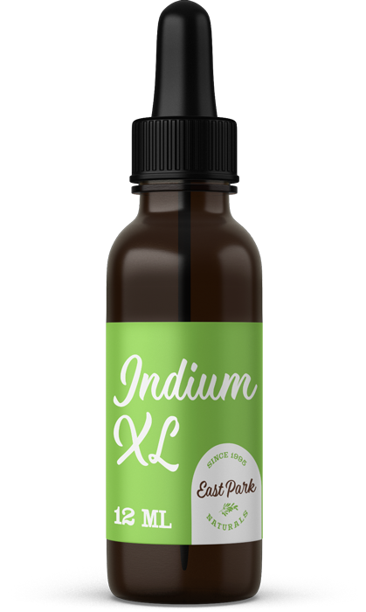
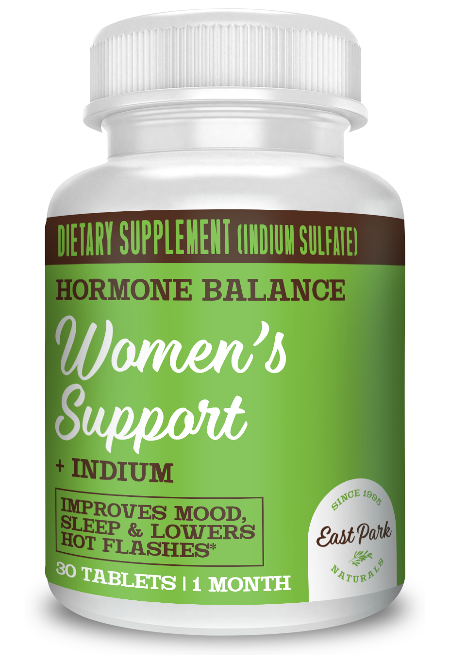
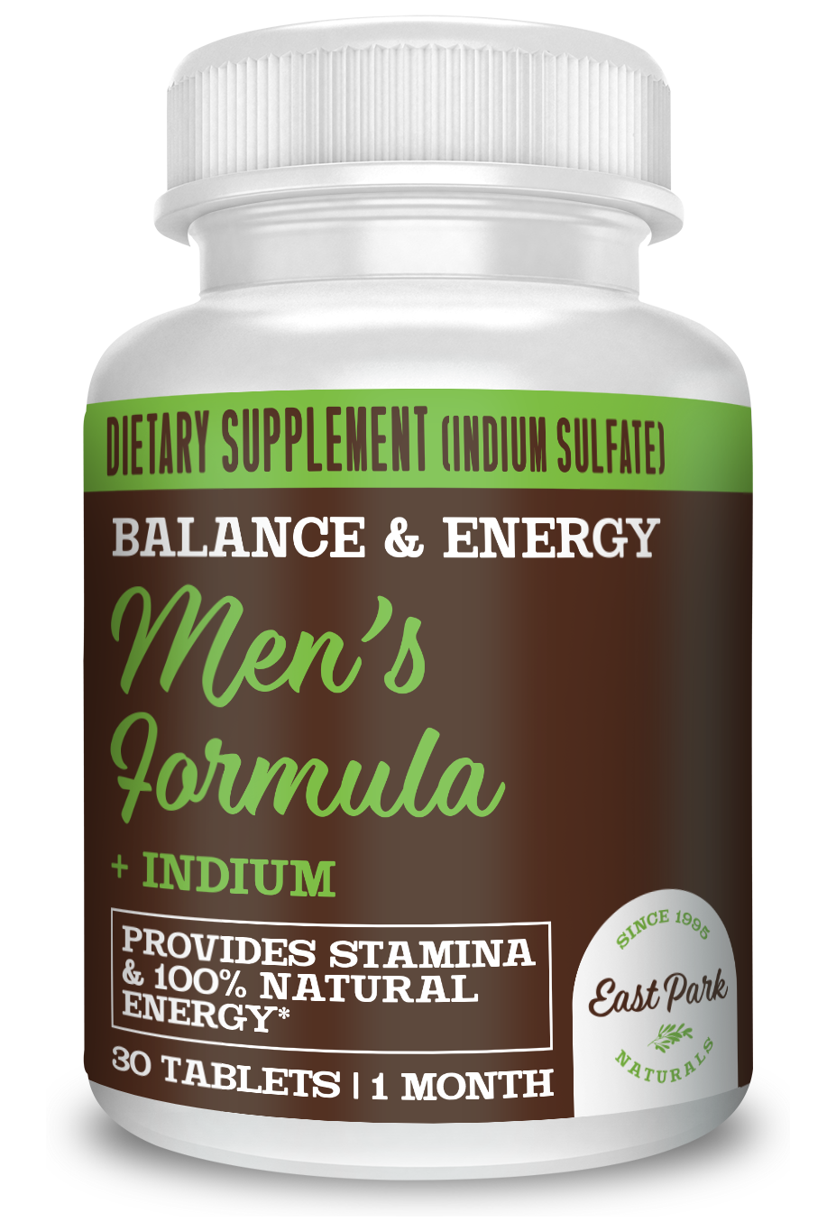
Indium + Real World …
Let’s Talk Real World….
2 Days
* Less Sleep Needed
* Better sleep and more energy
1 Week
* Sense of well being
* Taste sensitivity restored in elderly
* Sense of smell regained
10 Days
* Physical endurance increased

Slide 33
Indium + Real World …
2 Weeks
* Normalization of low blood sugar
* Hypoglycemia reduced to near normal
* Routine migraine headaches stopped
- some cases in as little as a few hours
* Normalization of saliva flow
* Person with Parkinson's walks and talks better
* Libido returned to normal for both male and female
3 Weeks
* Eye pain disappears

Slide 34
Indium + Real World …
Few Weeks
* Diabetic control of sugar level
2 Months
* Low blood pressure helped
* Menstrual cycle irregularity helped
* Hot flashes nearly gone
Few months
* Eye pressure, glaucoma normalized-gradually
* Intestinal and bowel problems helped
* Hair growth for both men and women returned and with natural color
6

Slide 35
Living Better Through Nature
Remember the title of this talk!
Revitalizing Health: A Natural
Solution to Hormone Balance
Mechanical Relief
Hormone Replacement Therapy
Bio-Identical Hormones
Phytoestrogen & androgen
Essential Trace Elements
Notes:
Everything is not all doom and gloom. Here are some options that you have available.

Slide 36
Living Better Through Nature
Remember the title of this talk!
Revitalizing Health: A Natural
Solution to Hormone Balance
Mechanical Relief
Hormone Replacement Therapy
Bio-Identical Hormones
Phytoestrogen & androgen
Essential Trace Elements
Notes:
Everything is not all doom and gloom. Here are some options that you have available.

Slide 37
Living Better Through ”Nature”
Reality: Look for 3 things!
Why? Are they just a “HOT” product?
What, does it “ACTUALLY” do?
What is the “EFFICACY”?
A Natural Solution to
Hormone Balance
Notes:
Everything is not all doom and gloom. Here are some options that you have available.

Slide 38
The Winning Combination
25 years of experience
Patented Ingredients
Researched & Tested
100% Natural Ingredients
Made in USA

Slide 39
NOT AVAILABLE ON AMAZON.COM

Slide 40
Download slides and watch presentation!

Slide 41
Thank You
Help Us Tell The World
Title: Revitalizing Health: A Natural Solution to Hormone Balance

Slide 42
Download slides and watch presentation!

